Slide 1
Cyber security
ASSIGNMENT-1

Slide 2
What is cyber security?
Cyber security is an protecting security. Cyber refers to Technology and security refers to protection .It is all about protecting computers, networks and data from unauthorized
access.
Types Of Cyber Security Attacks:
Active Attack & Passive Attack
1.Active Attack: when someone deliberately tries to gain unauthorized access to a
computer System or network. They might try to steal information ,distrupt services or even
also modify data .
1.Man-in-the-middle attack
2.spoofing
3.Dos attack
4.Phishing attack
5.Replay attack

Slide 3
Passive Attack
Passive Attack :we can see data what’s happening but we cant change it.
1.Computer Surveillance: monitoring of computer systems and activities to ensure
security prevent unauthorized access.
2.Network Surveillance :network traffic to detect and prevent security threats and
maintain the confidentiality and security o sensitive information.
3.Wire Tapping: interception and monitoring of electronic communications for
intelligence gathering or evidence

Slide 4
HACKERS CATEGORIES
1.Black Hat Hacker: These are the bad guys of hacking world.They use their skills to break into computer systems,networks,devices without permission.
2.White Hat Hacker: These are good guys of hacking world .They find vulnerabilities in computer systems,networks devices with permission.They help identitfy weakness.
3.Grey Hat Hacker:Both black hat hackers and white hat hackers.

Slide 5
Essential Terminologies :
1.malware:it can be used to steal sensitive information,damage computer
systems,spread to other computers or hold data and systems hostage.
2.IP Address: IP address is a unique numerical label used to identify and locate
devices on a network.
3.Phishing : Type of social engineering attack where attackers trick individuals into
revealing sensitive information.
4.Firewall: System that monitors and controls incoming and outgoing network traffic
based on predetermined security rules.
5.Social Engineering: It refers to the use of psychological manipulation and
deception tactics to trick individuals into revealing sensitive information.
6.Ransomware:It type of malicious software that encrypts a victims files and demands
payment in exchange for the decryption key.

Slide 6
Top 10 Most Notorious Hackers Of All Time In This Internet World:
1.Kevin Mitnik
2.Anonymous
3.Adrian Lamo
4.Albert Gonzalez
5.Matthew Bevan And Richard Pryac
6.Jeanson James Ancheta
7.Michael Calce
8.Kevin Poulsen
9.Jonathan James
10.Astra

Slide 7
Phases of Hacking
1.Reconnaisance/Footprinting
2.Scanning
3.Gaining Access
4.Maintaining Access
5.clearing Tracks

Slide 8
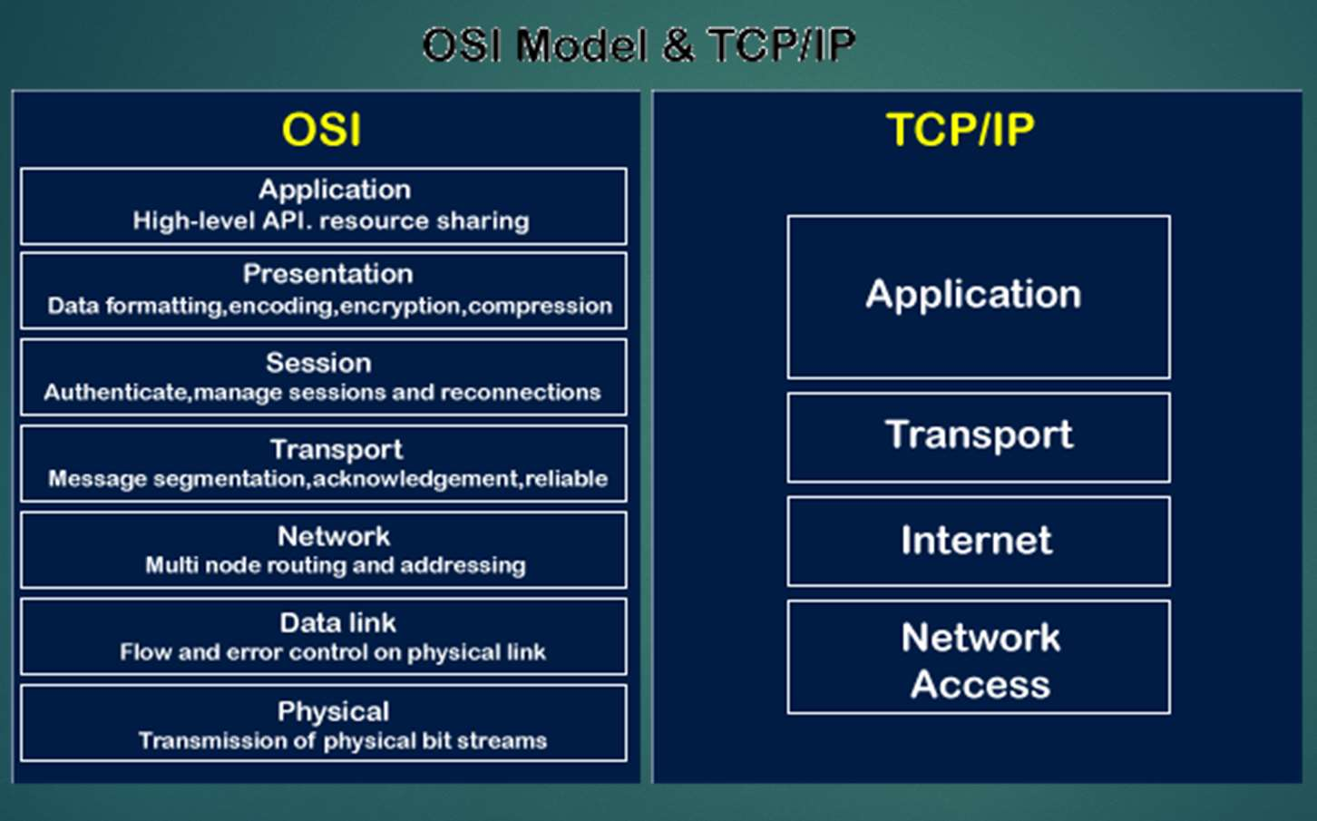
OSI AND TCP/IP MODEL

Slide 9
DASHBOARD OF CISCO PACKET TRACER
Cisco packet tracer is a network simulation and visualization tool developed by Cisco systems .it allows users to create visual networks and simulate network configuration, devices,and connections.it used for educational purpose,such as teaching networking concepts and practicing network troubleshooting.

Slide 10
What is python
It is a versatile programming language,is widely used in the field of cybersecurity and hacking due to its simplicity,flexibility and extensive libraries.
WHY PYTHON ?
It is offers readability,easy of learning,and a vast ecosystem of libraries,making it ideal for hacking tasks such as penetration testing, network scanning,and automation.

Slide 11
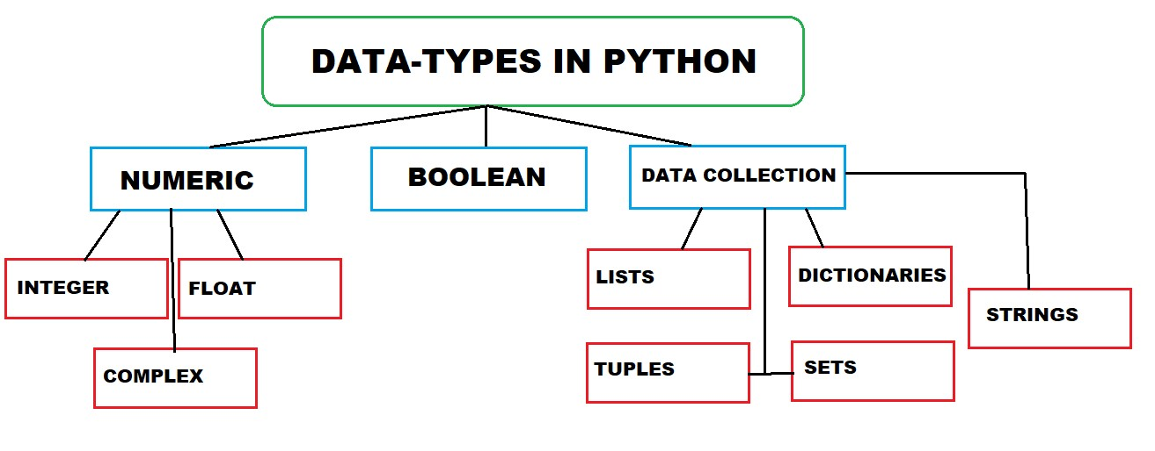
DATA TYPES

Slide 12
TOP 10 WEB APPLICATION SECURITY RISKS
A01:2021:Broken Access Control
A02:2021-Cryptographic Failures
A03:2021-injection
A04:2021-Insecure Design
A05:2021-Security Misconfiguration
A06:2021-Vulnerable and outdated components
A07:2021-Identification and Authentication Failures
A08:2021-Software and Data integrity Failures
A09:2021-Security Logging and monitoring failures
A10:Server-side Request Forgery

Slide 13
Web Application Hacking Methodology
1.foot printing web infrastructure
2.analyze web application
3.by pass client inside controls
4.Attack Authentication mechanism
5.Attack Authorization schemes
6.Attack Access Controls
7.Attack Session Management Mechanism
8.Perfor Injection Attacks
9.Attack Application Logic Flaws
10.Attack Shared Environments
11.Attack Database Connectivity
12.Attack web client

